Slide 1
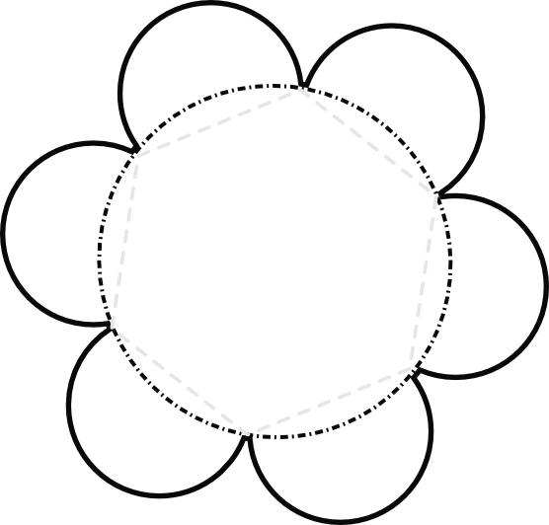
Interesting fact!
Who invented it?
Assembly for the Flower Flap Book
Cut the flower out on the solid lines. Fold the petals down on the gray dotted lines with the text inside the flaps. Write subtitles on the top of each petal.
How was it made?
Picture and explanation of what the invention was
When was it invented
Is it still useful today?
How did it change society?

Slide 2
Assembly for the Flower Flap Book
Cut the flower out on the solid lines. Fold the petals down on the gray dotted lines with the text inside the flaps. Write subtitles on the top of each petal.

