Slide 1
Beliefs and Philosophies
A philosophy is a set of beliefs resulting from a search for truth, or knowledge about the nature of the universe.
This search for truth began when there were a lot of wars and life in ancient China was uncertain.

Slide 2
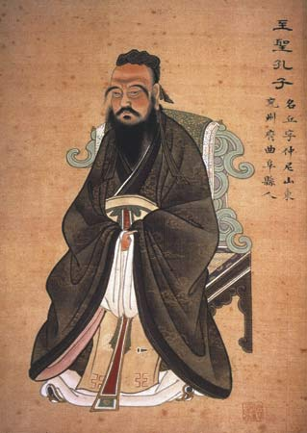
Confucianism
Confucius aimed to teach the ancient people of China about developing their “moral virtues”, which is the goodness within all of us. He believed in building a just and stable society, where everyone has a place in society, and the family was the most important structure.

Slide 3
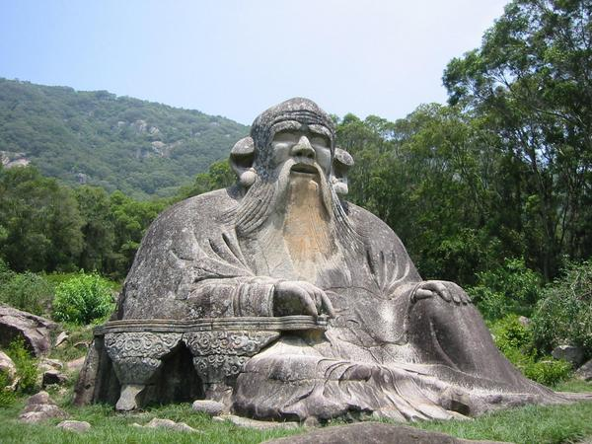
Taoism
Laozi was the founder of Taoism, and he believed that people should learn from nature and live simple lives that are in harmony with nature as much as possible. He thought that people should not follow rules set up by men, rather they should follow rules set up by nature.

Slide 4
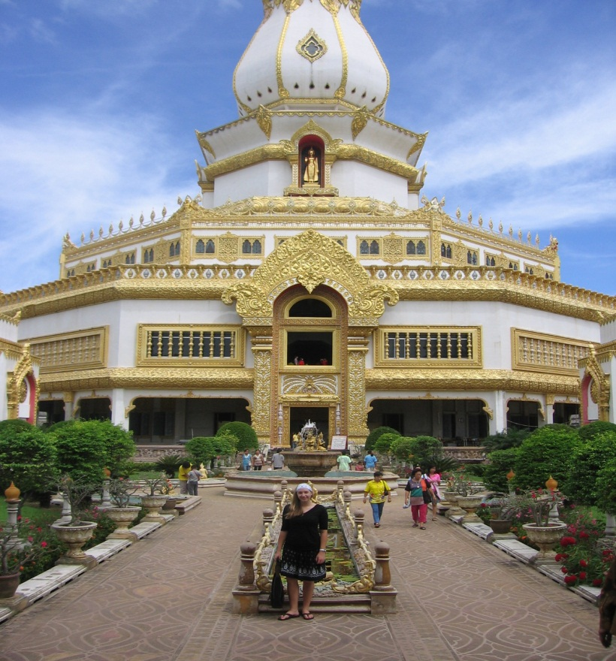
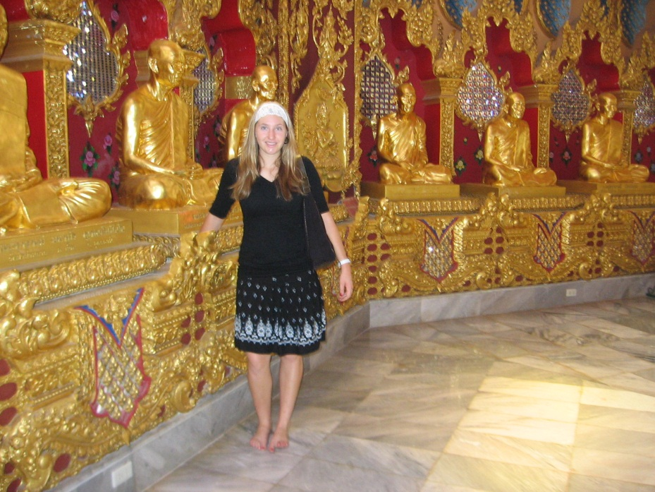
Buddhism
It is philosophy that 'means love of wisdom' and the Buddhist path aims to lead a moral life, to be mindful and aware of thoughts and actions, and to develop wisdom and understanding.
Buddhism was introduced to China from India about 600 years after Confucianism, but is the most widely spread practiced religion in China today.

