Slide 1
Terracotta Warriors

Slide 2
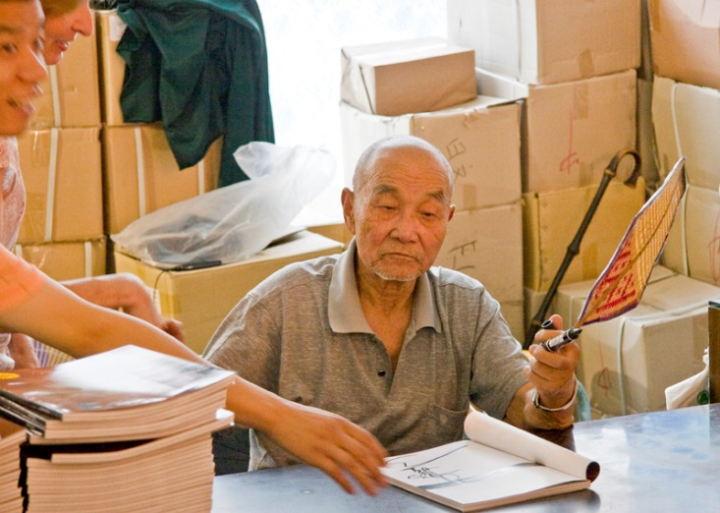
Discovered accidentally in 1974
Seven-strong team of workers who, while digging a well on their communal farm in Yang village in 1974, stumbled across the most priceless archaeological discovery of modern times: the 2,200-year-old Terracotta Army.

Slide 3
What they found
Over 2,200 years old, the army consists of approximately 8000 soldiers, 650 horses, and 130 chariots. The army is believed to have taken 11 years to create, from the efforts of 700,000 workers.

Slide 4
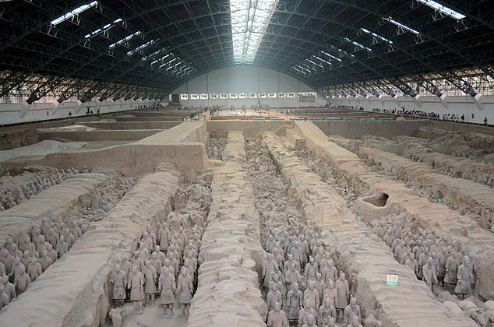
The soldiers stand at approximately six feet tall. Each face is unique, and their outfits and height vary by rank.

Slide 5
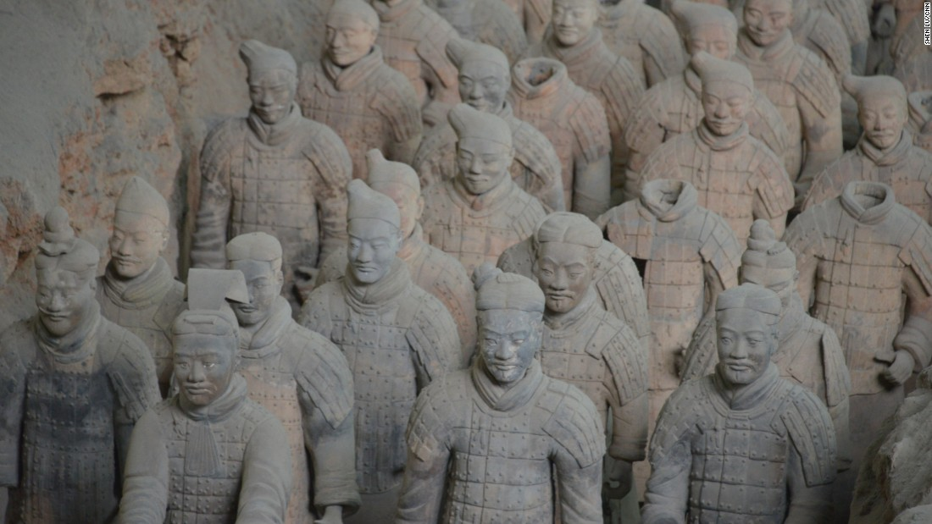

Slide 6
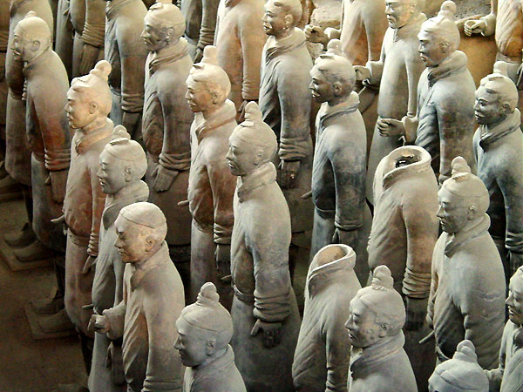

Slide 7
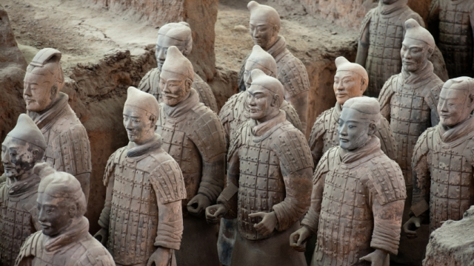

Slide 8
How did they get there?!
Shi Huangdi was only 13 years old when he came to power. He ruled from 221 B.C. until 207 B.C. No sooner did he become emperor, than he began preparing for his death. He ordered more than 700,000 workers to build his underground tomb.
The grandest tomb of any emperor, it stood more than 15 stories high and covered about three acres. To surround the tomb, artists fashioned a clay army of thousands of soldiers, horses, and chariots. Just as Shi Huangdi's real army protected the emperor in life, his clay army was to guard him death.
Each clay figure was made one at a time. No molds were used. Each soldier had a different face, probably the likeness of a real soldier. Each was made slightly larger than the real person. Some of the soldiers carried real spears and swords.

Slide 9
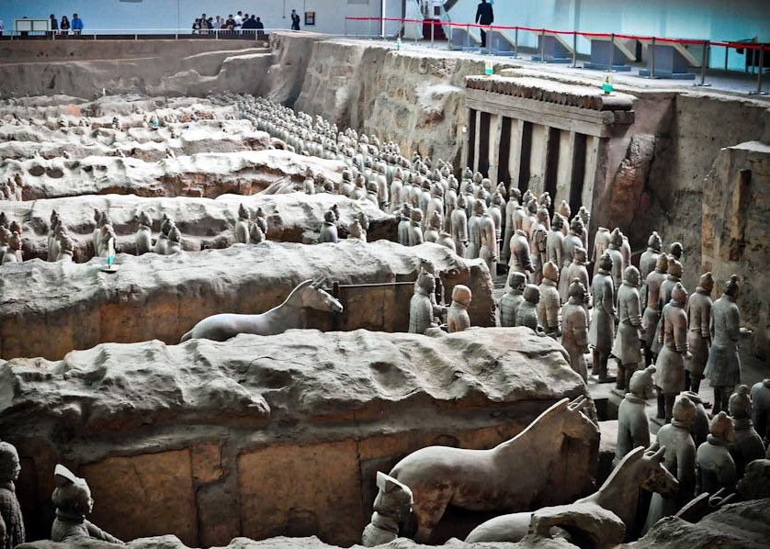

Slide 10
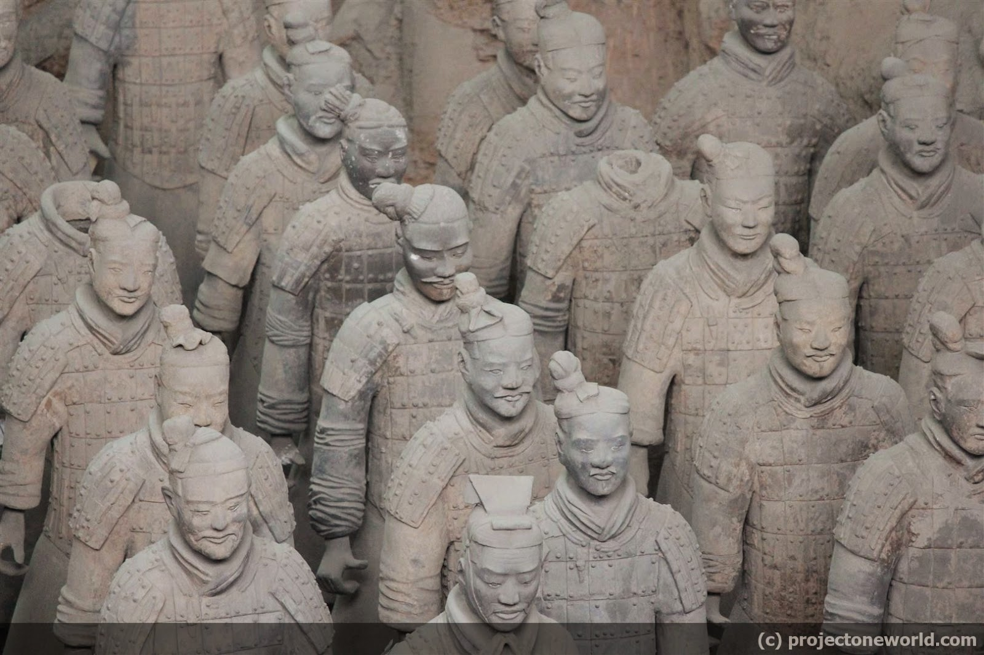

Slide 11
No two are the same
About two thousand soldiers have been unearthed so far, yet, amazingly, so far no two are the same. The army includes men of all different ages, from all different parts of China. A young soldier looks both excited and nervous; an older officer appears tired. Some soldiers seem lost in thought, possibly dreaming of their return home; others look profound and confident.
Hundreds of craftsmen spent more than ten years in workshops near the pits creating warriors. If they made a mistake, they were killed.

Slide 12
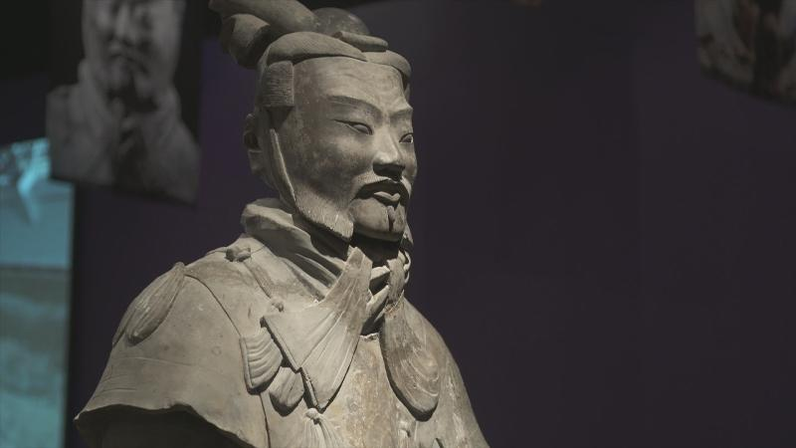

Slide 13
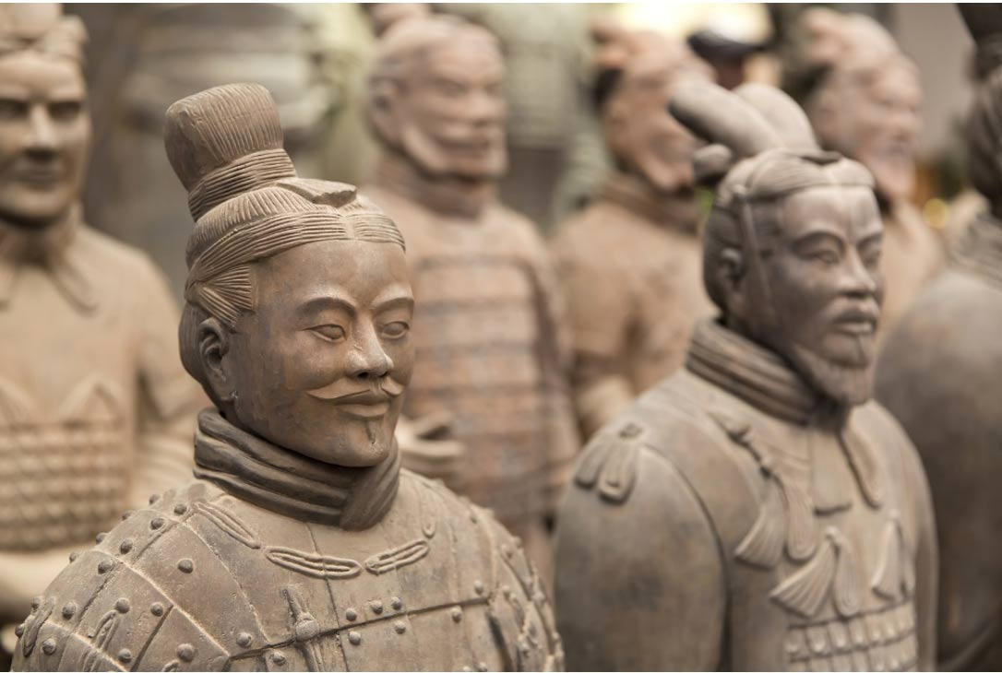

Slide 14
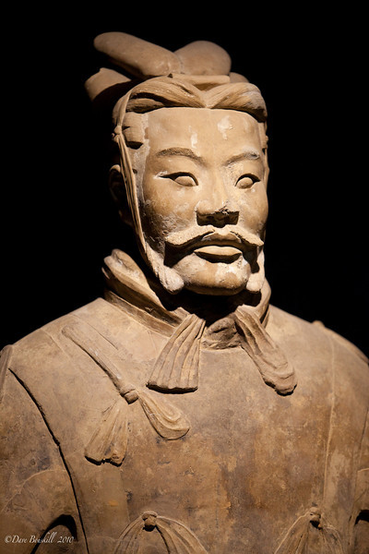
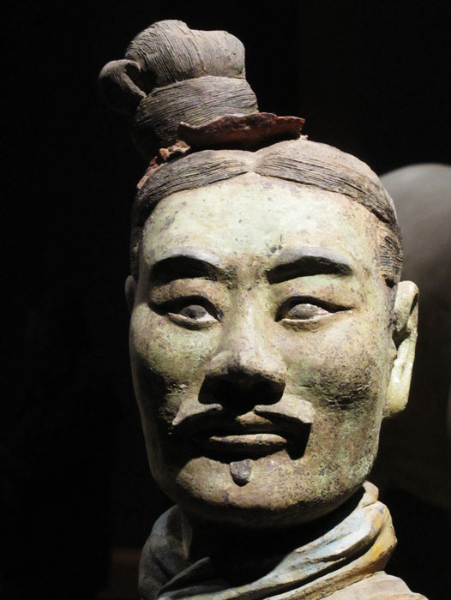

Slide 15
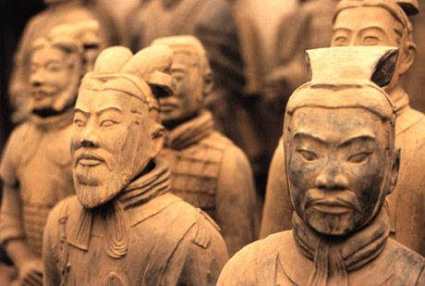

Slide 16
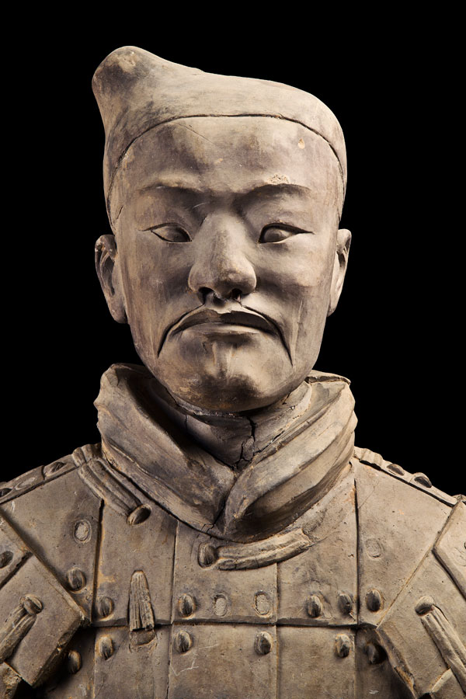
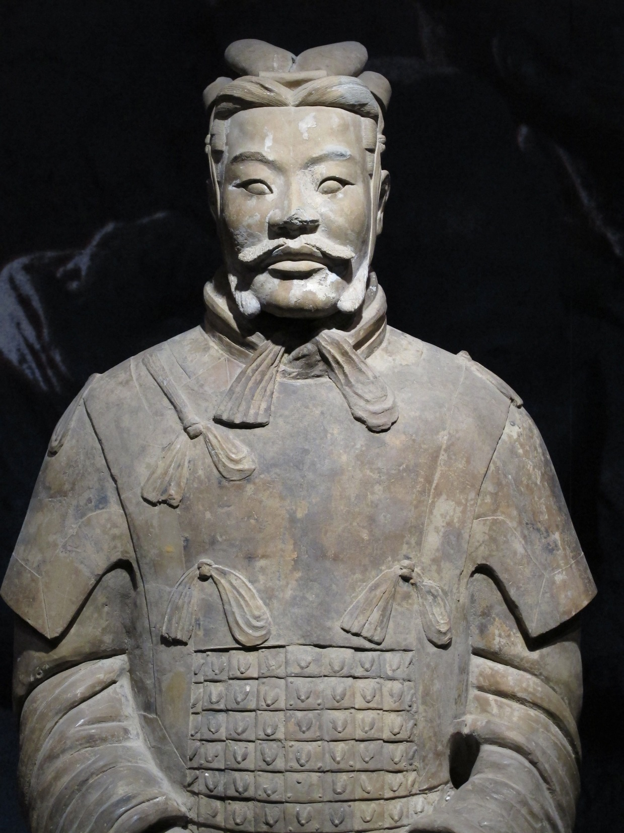

Slide 17
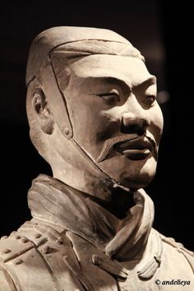
https://www.youtube.com/watch?v=mP5p4QbvPtc
https://www.youtube.com/watch?v=RsUE-ZtcUFg

Slide 18
You get to make your own Warrior!
There are 6 different types of warriors your class will be making.
Soldier in battle dress Mid-ranking officer
Soldier in armour High-ranking officer (general)
Low ranking officer Charioteer
You will draw a paper randomly find out which soldier you will get to make!

Slide 19
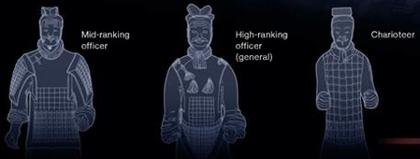

Slide 20
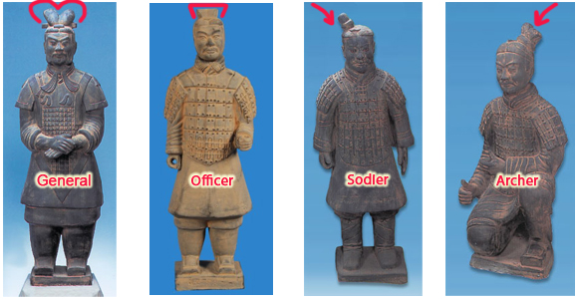

Slide 21
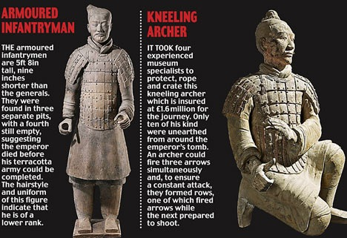

Slide 22
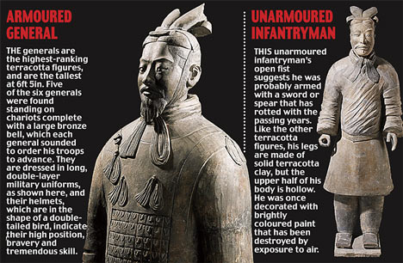

Slide 23
What’s the difference?!
The warriors are different based on rank! You will need to think about clothing, hair style, head gear, facial features, facial hair and body position!
You will also be doing a writing assignment to tell us the story of your warrior.

Slide 24
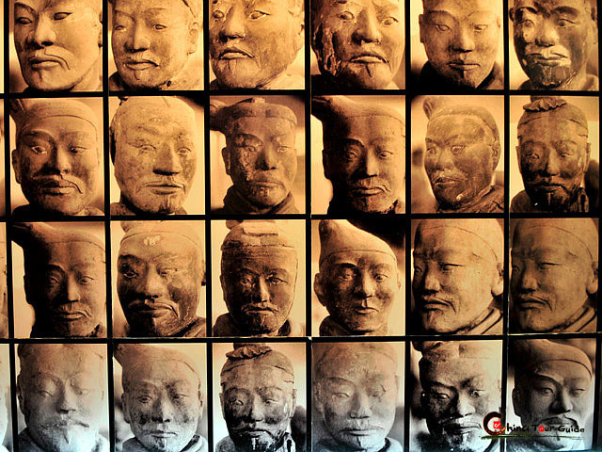

Slide 25
Each facial feature indicated a different type of personality. For example, a person with a broad forehead and a pointed chin was thought to be watchful and alert. Many warriors with these features are found in the front of the clay army, where a special alertness to approaching danger would be valuable
Most warriors have long hair that is braided and gathered up into a knot on top of the head. Some wear knots in the center of the head, others off to a side. Others even more differently based on rank.
Some have beards or mustaches, while others are clean shaven.

Slide 26
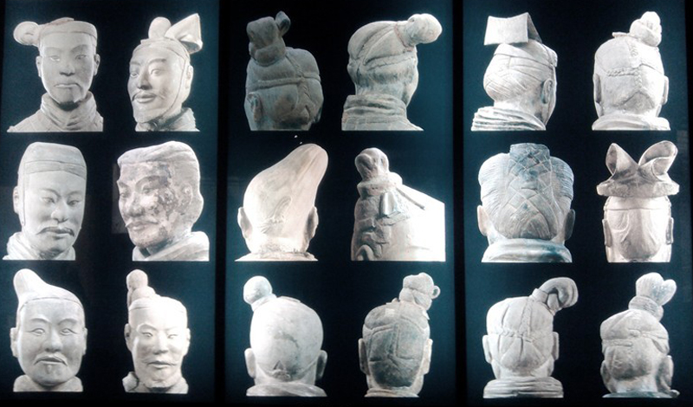

Slide 28
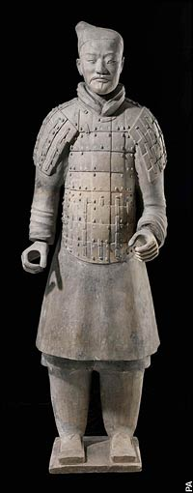
Charioteer
There were only about 50 charioteers and each had a team of four horses. They were Mongolian ponies so were not very big but were muscular and full of power. The mane of each horse was trimmed short and its tail braided
Charioteers are easily recognizable by their posture. Their arms are held stiffly
forward with closed fists as if holding the reins, with index and middle fingers separated to control the lines.
Charioteers dressed in full armour.

Slide 29
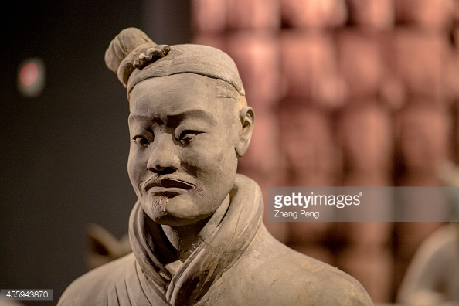
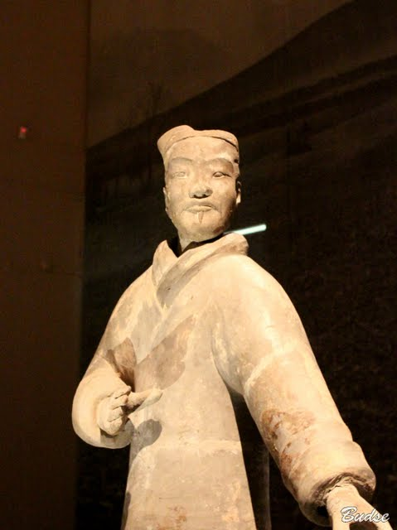
Soldiers
All soldiers are wearing tunics, puttees and boots with square tips
Lowest rank had bare heads and wore heavy knee-length tunics but no amour. This allowed them to move quickly.
Often their legs were wrapped in cloth shin guards for protection.

Slide 30
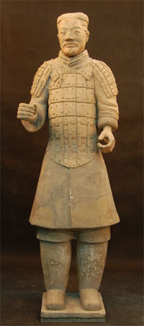
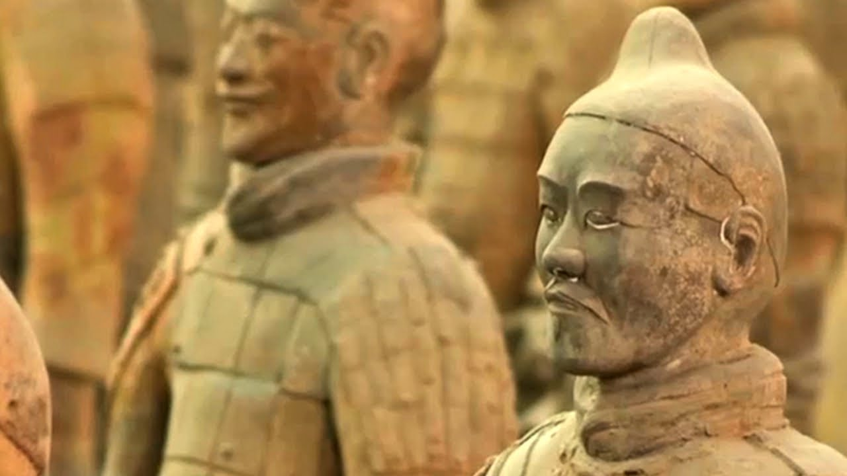
Solider with Armour

Slide 31
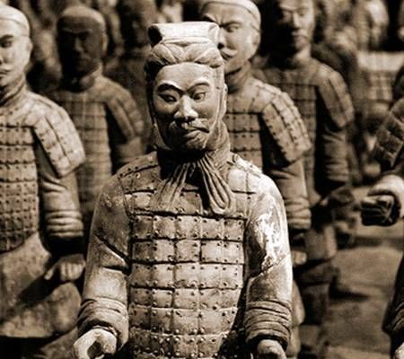
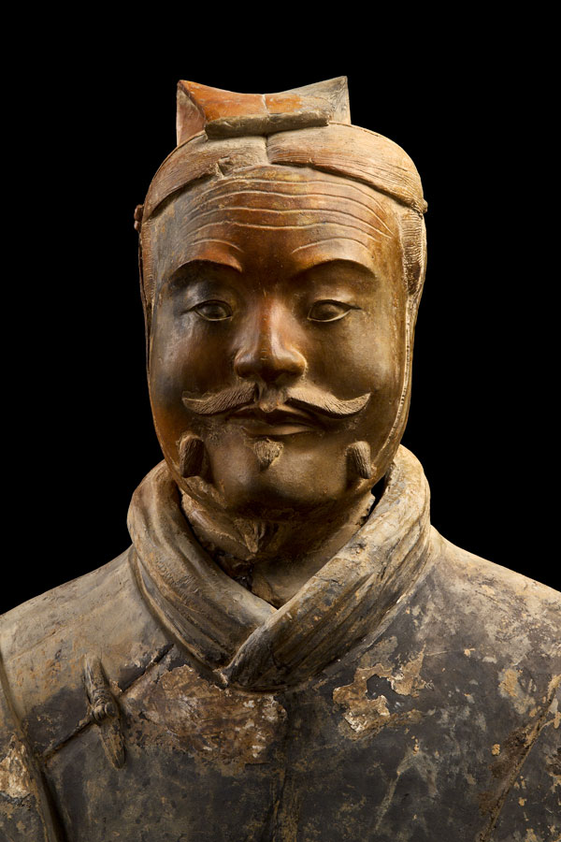
Lower Rank Officers
Offices are distinguished by their massive bodies, their armour and their double tunics.

Slide 32
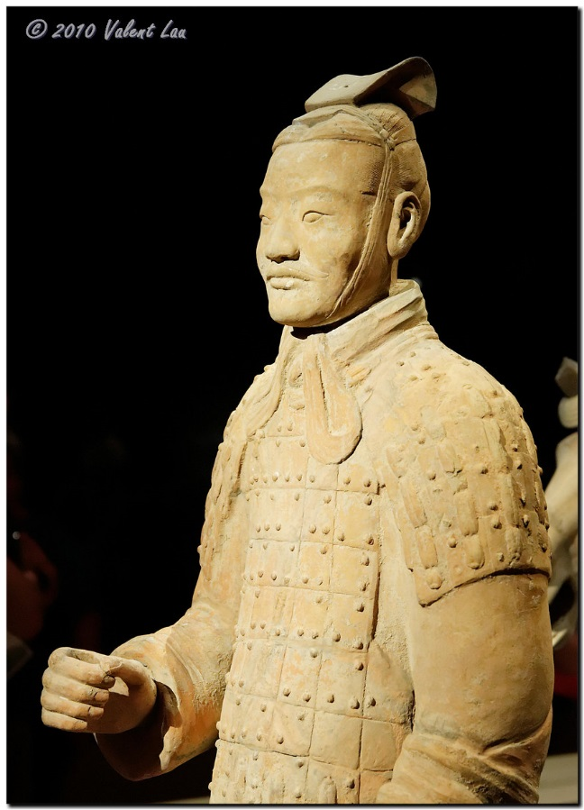
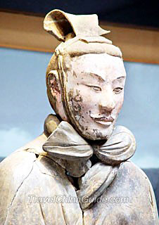
Medium Rank Officer

Slide 33
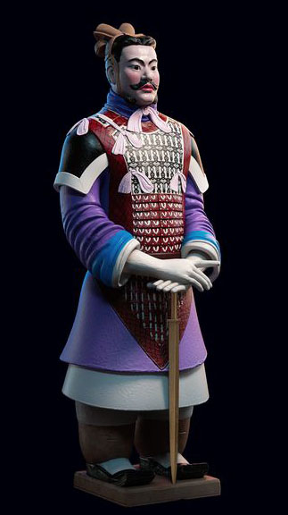
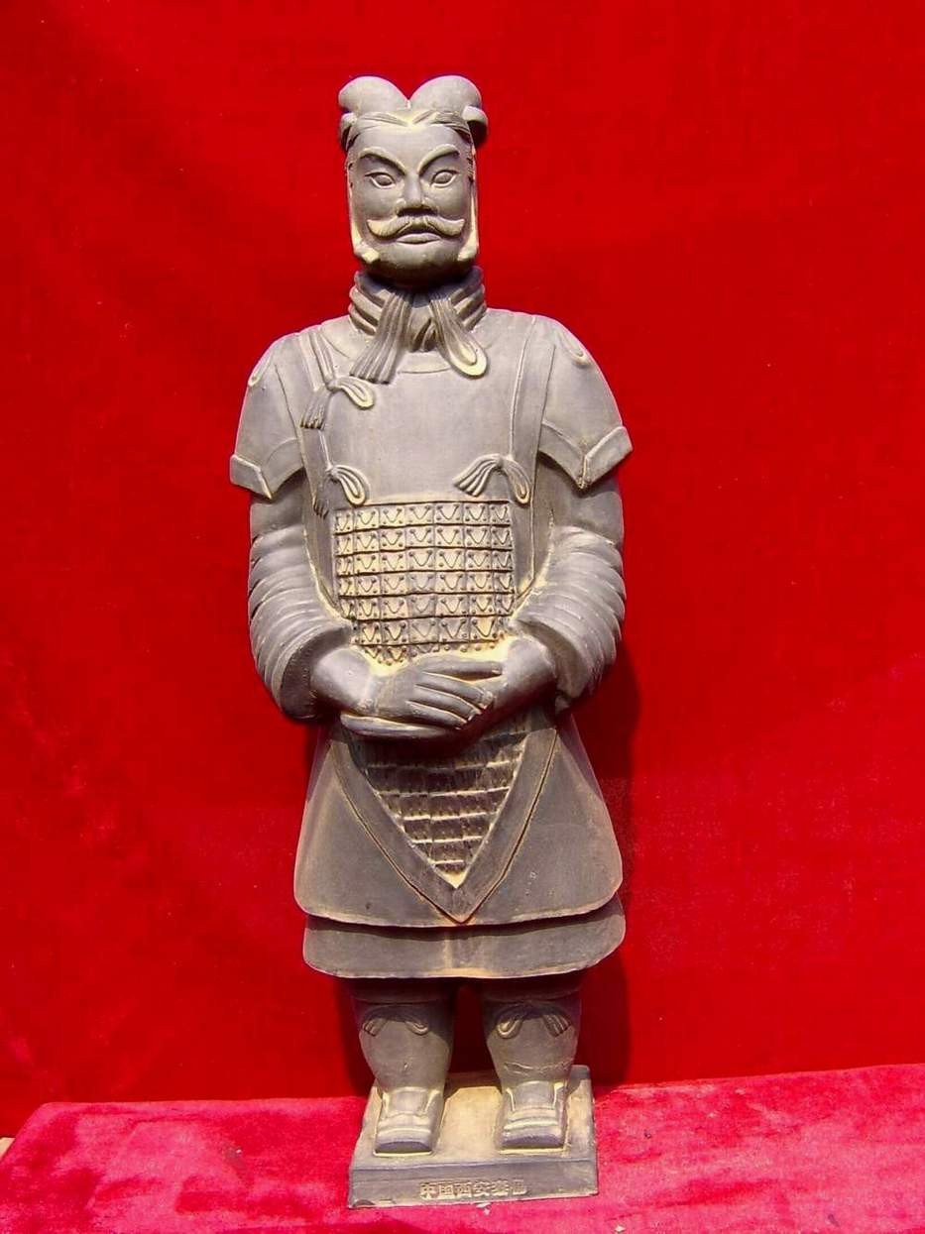
High Rank Officer (General)
A general’s uniform was more elegant. Their caps sometimes had a feather, their fancy shoes curl up at the toes, and their fine amour is made from small iron fish scales. Tassels on their amour are also a mark of their rank.
They had a double layer of robes with plates of armour across the chest.

